Slide 1
Using the Linux Servers
Code Camp Week 2

Slide 2

What are they?
The Linux servers are a bunch of machines that are running the Linux operating system
They have software that is useful and necessary for UCLA computer science courses
Professors test student code using these servers

Slide 3
Software Used
On Windows
On Mac
Cisco AnyConnect
Used as VPN
Need to download Putty
Used to login to the server
Optional download: WinSCP
Used to transfer files to/from the server
Use the Terminal app to login to the server
Optional download: Cyberduck
Used to transfer files to/from the server

Slide 4
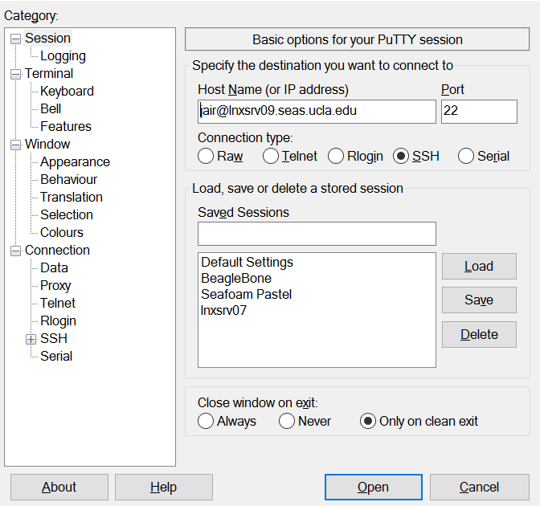

Signing In: Windows
SEASnet username
Name of the server

Slide 5
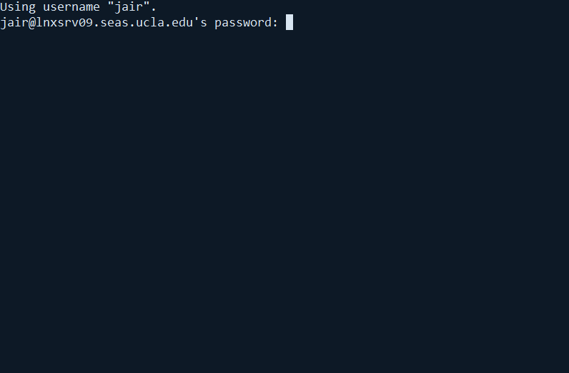
Signing In: Windows
Type in your SEASnet password
If no characters appear, don’t worry, that is normal
Hit enter when you are done

Slide 6
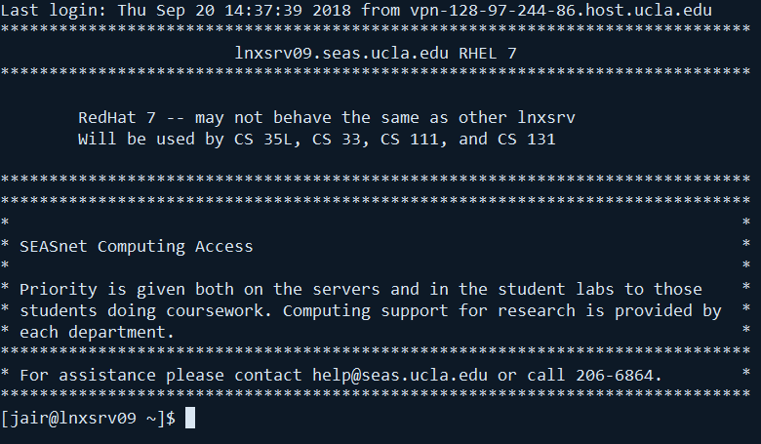
Signing In: Windows
If you see a page similar to this, you are done!

Slide 7
Using the System
The servers run on a command line interface
The system provides a set of commands to navigate and use the system
The alternative is providing a graphical interface like Windows or MacOS
Navigating the file system:
ls: Print the current directory
mkdir <dir>: Create a directory with the name “dir”
cd <dir>: Go into the directory with the name “dir”
emacs <file>: Modify or create a file with name “file”
This is a text editor used to write files
Has lots of integrated commands

Slide 8
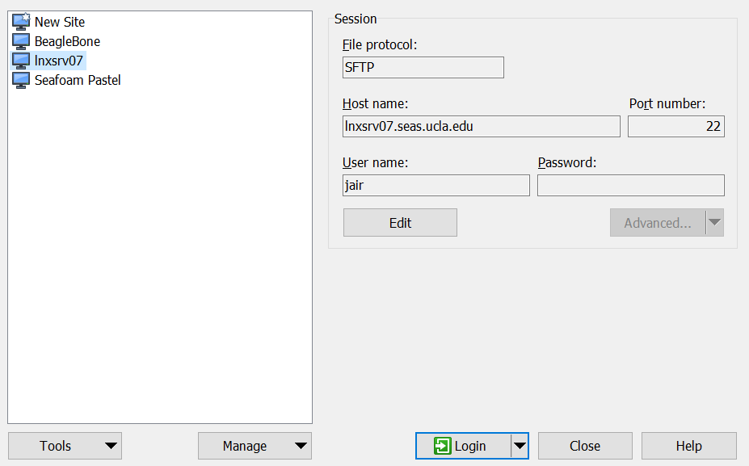
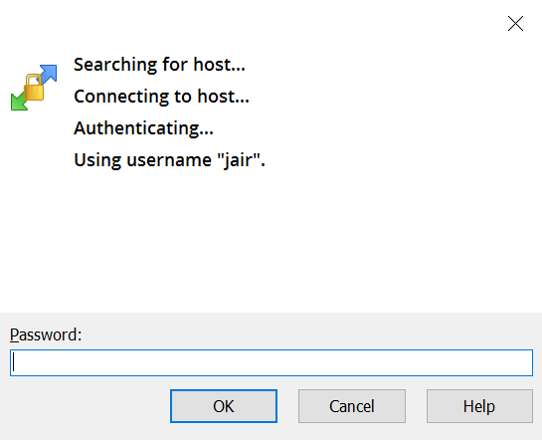
Getting Files on the Server: Windows

Slide 9
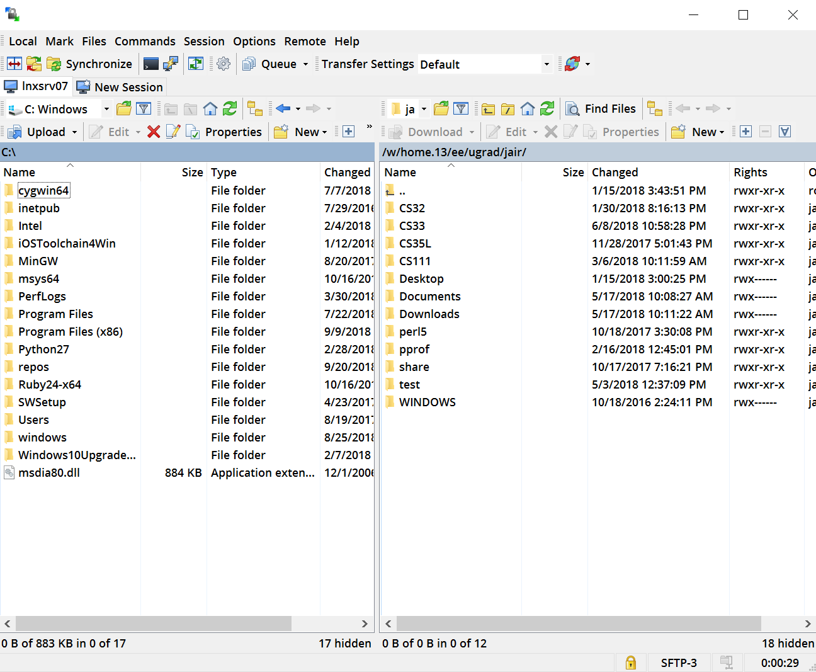
Getting Files on the Server: Windows
The left is your local computer file system
The right is the Linux server file system
You could easily drag and drop across both

Slide 10
Compiling and Running Code
To compile code you use the following command
g++ -o <name of executable> <name of cpp file>
eg: g++ -o test test.cpp
To run the executable and test your code you use
./<name of executable>
eg: ./test

